Slide 1



Kumar P
Author: Kumar Kumar
Created with Pi

Slide 2

CONTENTS
II B.Sc. Computer Science
About Me

Slide 3

01
II B.Sc. Computer Science

Slide 4

II B.Sc. Computer Science
Email: kkumar37411@gmail.com

Slide 5

02
About Me

Slide 6
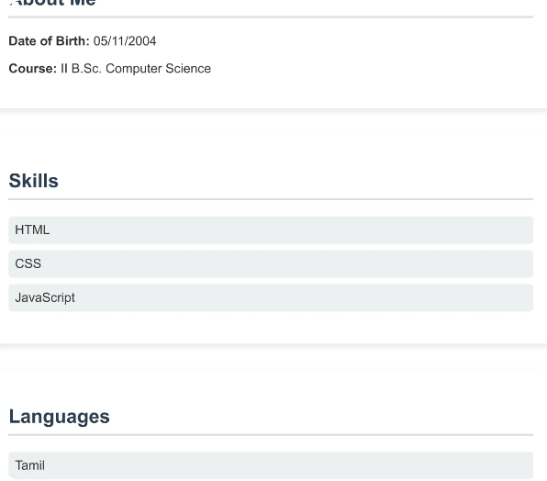
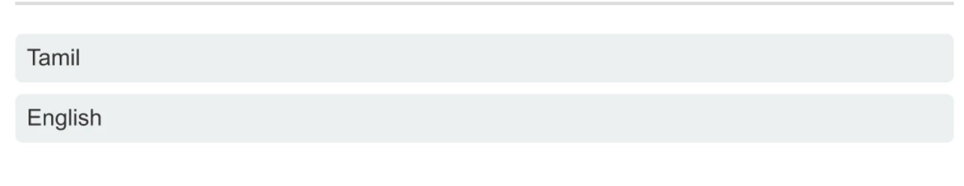
About Me
Explore our developer-friendly HTML to PDF API | Printed using PDFCrowd | HTML to PDF

Slide 7

Thank You

